Slide 1
Module 3.2
Query Operations

Slide 2
Query Modification
Approaches for Improving initial query formulation through query expansion and term reweighting.
Relevance feedback
approaches based on feedback information from users
Local analysis
approaches based on information derived from the set of documents initially retrieved (called the local set of documents)
Global analysis
approaches based on global information derived from the document collection

Slide 3
Relevance Feedback
The main idea consists of selecting important terms, or expressions, attached to the documents that have been identified as relevant by the user, and of enhancing the importance of these terms in a new query formulation.
The expected effect is that the new query will be moved towards the relevant documents and away from the non-relevant ones.
Two basic techniques
Query expansion
addition of new terms from relevant documents
Term reweighting
modification of term weights based on the user relevance judgement

Slide 4
Advantages of Relevance Feedback over other query reformulation strategies
Relevance feedback process
it shields the user from the details of the query reformulation process because what the user has to provide is a relevance judgement on documents.
it breaks down the whole searching task into a sequence of small steps which are easier to grasp.
it provides a controlled process designed to emphasize some terms and de-emphasize others

Slide 5
Query Expansion and Term Reweighting in Vector Space Model

Slide 6
Query Expansion and Term Reweighting for the Vector Model
The application of relevance feedback to the vector model considers that —
1. relevant documents resemble each other.
2. non-relevant documents have term-weight vectors which are dissimilar from the ones for the relevant documents.
The basic idea is to reformulate the query such that it gets closer to the term-weight vector space of the relevant documents.

Slide 7
Query Expansion and Term Reweighting
In the Vector Space Model (VSM), Query Expansion and Term Reweighting are techniques used to enhance the effectiveness of information retrieval by refining the user's query and adjusting the importance of terms within that query.

Slide 8
Query Expansion
Query Expansion involves modifying the original user query to include additional terms that are semantically related or highly relevant to the original terms.
The goal is to capture more relevant documents that might not be retrieved with the original query terms alone.

Slide 9
Query Expansion Methods
Synonym Expansion: Adding synonyms of the query terms.
For example, if the query is "car," the system might expand it to include "automobile."
Stemming or Lemmatization: Expanding the query to include different forms of a word.
For example, "run" might be expanded to include "running," "ran," etc.
Thesaurus-based Expansion: Using a thesaurus to find related words.
For example, "data mining" might be expanded to include "knowledge discovery."
Relevance Feedback: Based on user feedback, expanding the query with terms found in relevant documents.
If a user marks documents containing "text mining" as relevant, the query might be expanded to include "text mining."
Co-occurrence or Statistical Methods: Identifying terms that frequently co-occur with the original query terms in the document corpus.
For example, if "artificial intelligence" frequently co-occurs with "machine learning," the query might be expanded to include "machine learning."

Slide 10
Example
Original Query: "data mining"
Expanded Query: "data mining" OR "knowledge discovery" OR "text mining" OR "data analysis"
The expanded query improves recall by retrieving documents that contain any of the expanded terms, thus covering a broader range of relevant documents.

Slide 11
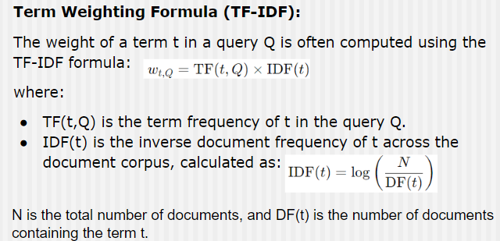
2. Term Reweighting
Term Reweighting in the Vector Space Model adjusts the importance (weight) of each term in the query vector to better reflect its significance in retrieving relevant documents.
The weights are typically based on the term's frequency in the document(TF) and its inverse document frequency (IDF).

Slide 12

Reweighting Process
Initial Weight Assignment: Initially, each term in the query is assigned a weight based on TF-IDF.
Relevance Feedback: If relevance feedback is available (e.g., the user marks certain documents as relevant), the system can reweight terms based on their occurrence in relevant versus non-relevant documents.
Rocchio Algorithm (Example): The Rocchio algorithm can be used to adjust the query vector by emphasizing terms in relevant documents and de-emphasizing those in non-relevant ones:
This reweighting adjusts the query vector to improve the retrieval of relevant documents.

Slide 13
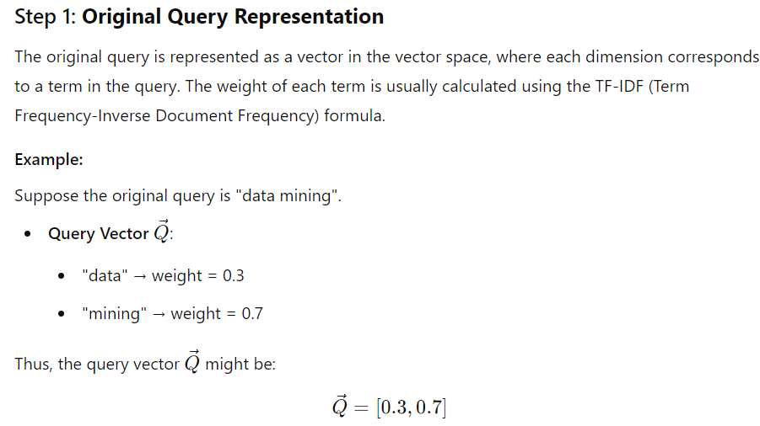
Example

Slide 14


Slide 15


Slide 16


Slide 17
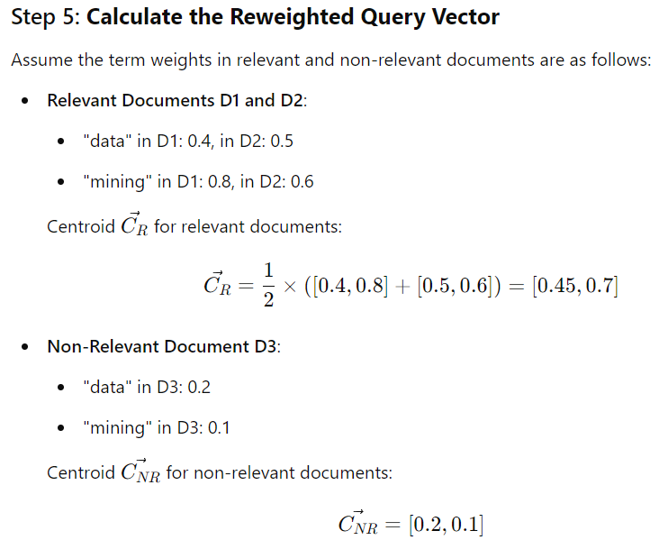

Slide 18
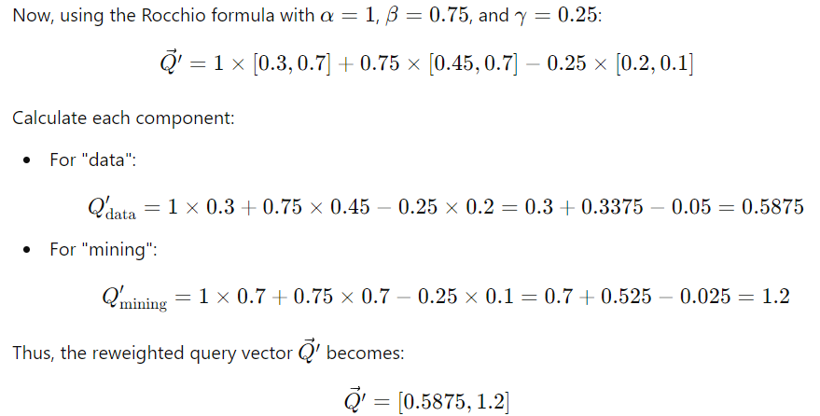

Slide 19
Step 6: Interpret the Reweighted Query
The reweighted query vector indicates that the term "mining" has gained more importance relative to "data" based on the feedback.
When this new query vector is used to search the document collection, it will prioritize documents that emphasize "mining" more strongly, thus likely improving the relevance of the retrieved documents.

Slide 20
Summary
Original Query: A simple vector based on initial term weights.
Relevance Feedback: Incorporates user feedback on document relevance.
Rocchio Algorithm: Adjusts the original query vector by adding information from relevant documents and subtracting influence from non-relevant ones.
Reweighted Query: A new query vector with updated term weights, which better reflects the user's true intent and improves the accuracy of search results.

Slide 21
Adv and Disadv of relevance feedback techniques
The main advantages of the above relevance feedback techniques are simplicity and good results.
The simplicity is due to the fact that the modified term weights are computed directly from the set of retrieved documents.
The good results are observed experimentally and are due to the fact that the modified query vector does reflect a portion of the intended query semantics.
The main disadvantage is that no optimality criterion is adopted:
Without an optimality criterion, there's no systematic way to evaluate whether the query modifications are actually improving the relevance of search results. The modifications might be based on heuristic or ad-hoc adjustments rather than a principled approach. This can lead to suboptimal query changes that do not significantly enhance the retrieval performance.

Slide 22
Term Re-Weighting for the Probabilistic Model
Term reweighting in probabilistic models is the process of adjusting the weights (or importance) of query terms based on their estimated relevance to improve the effectiveness of the information retrieval system.
The goal is to enhance the ranking of documents by giving more weight to terms that are more indicative of relevance and less weight to terms that are less informative.
In probabilistic models like the Binary Independence Model (BIM), term reweighting is often influenced by relevance feedback from users, which allows the model to better estimate the probabilities associated with terms in relevant and non-relevant documents.

Slide 23

Basic Concept of Term Reweighting in Probabilistic Model
The idea behind term reweighting in a probabilistic model is to adjust the weight of each term in a query based on the likelihood that the term appears in relevant documents versus non-relevant ones.
This adjustment is typically guided by the following probabilities:
Relevance Feedback and Rocchio-like Adjustments in Probabilistic Models
To reweight the terms after initial retrieval, relevance feedback is used.
The user provides feedback on which documents are relevant or non-relevant. This feedback is then used to update the term probabilities and reweight the query terms accordingly.

Slide 24

Term Reweighting Process
Initial Query Weight Calculation:
Initially, each query term is assigned a weight based on the likelihood ratio:
This weight indicates how much evidence the presence of term t provides for the relevance of a document.
2. Collecting Relevance Feedback:
After the initial retrieval, the user marks certain documents as relevant or non-relevant.
This feedback allows the system to re-estimate the probabilities P(t ∣ R=1) and P(t ∣ R=0)more accurately.

Slide 25

Term Reweighting Process
3. Updating Term Weights:
Using the feedback, update the term weights:
If a term frequently appears in the relevant documents but not in non-relevant ones, its weight will increase, indicating that it is a strong indicator of relevance.
Conversely, if a term appears more in non-relevant documents, its weight will decrease.

Slide 26
Term Reweighting Process
4. Re-ranking the Documents:
The reweighted query is used to re-rank the documents, ideally pushing more relevant documents higher in the ranking.

Slide 27
Example
Scenario:
Suppose you have a collection of documents, and a user is searching for information on "machine learning" The system needs to rank documents based on their relevance to this query. Initially, the system will use the BIM to assign weights to terms in the query and then apply relevance feedback to reweight the terms.
Step 1: Initial Setup
Document Collection:
Let's consider a small set of documents:
Document 1 (D1): "Machine learning and AI"
Document 2 (D2): "Deep learning in medical applications"
Document 3 (D3): "Introduction to machine learning"
Document 4 (D4): "Applications of machine learning"
Document 5 (D5): "AI and deep learning techniques"
User Query: "machine learning."

Slide 28

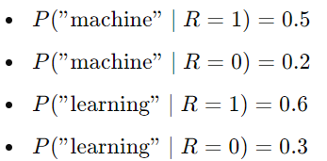
Step 2: Initial Term Weighting Using BIM and initial document scoring
The Binary Independence Model assumes that terms are independent and assigns weights to terms in the query based on their presence or absence in the documents.
Terms in Query: Term 1: "machine" and Term 2: "learning"
Probability Calculation:
Let’s assume we don’t initially know which documents are relevant, so we estimate these probabilities from the document collection.
Term Frequencies:
"machine" appears in D1, D3, and D4. (3 out of 5 documents)
"learning" appears in D1, D2, D3, D4, and D5. (5 out of 5 documents)
Now, let’s assume the initial probabilities:
D1: "Machine learning and AI"
D2: "Deep learning in medical applications"
D3: "Introduction to machine learning"
D4: "Applications of machine learning"
D5: "AI and deep learning techniques"

Slide 29
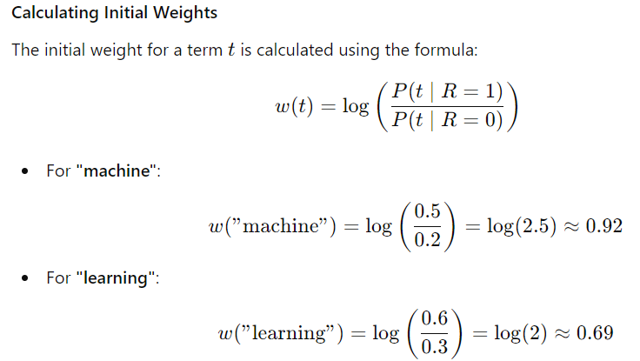

Slide 30

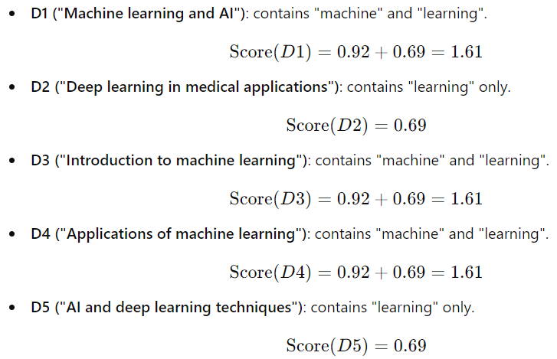
Initial Document Scoring

Slide 31
Step 3: Relevance Feedback and Term Reweighting
Suppose the user reviews the results and marks D1, D3 and D4 as relevant and D2,D5 as non-relevant.
Updating Probabilities:
Based on the feedback:
Relevant Documents (D1, D3,D4):
"machine": Appears in 3 out of 3 relevant documents.
"learning": Appears in 3 out of 3 relevant documents.
Non-Relevant Document (D2,D5):
“machine”: Appears in 0 out of 2 non-relevant document.
"learning": Appears in 2 out of 2 non-relevant document.
D1: "Machine learning and AI"
D2: "Deep learning in medical applications"
D3: "Introduction to machine learning"
D4: "Applications of machine learning"
D5: "AI and deep learning techniques"
Calculate Updated probabilities

Slide 32




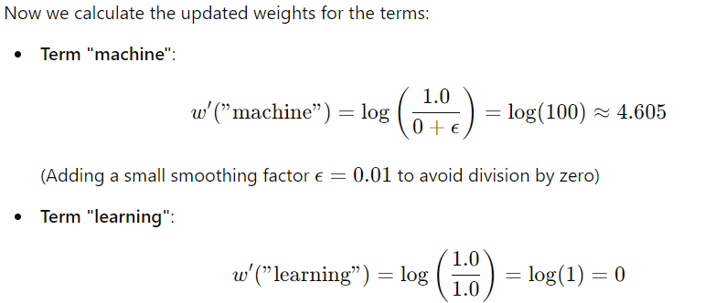
Updated Probabilities:
Reweighting Terms using updated probabilistic

Slide 33
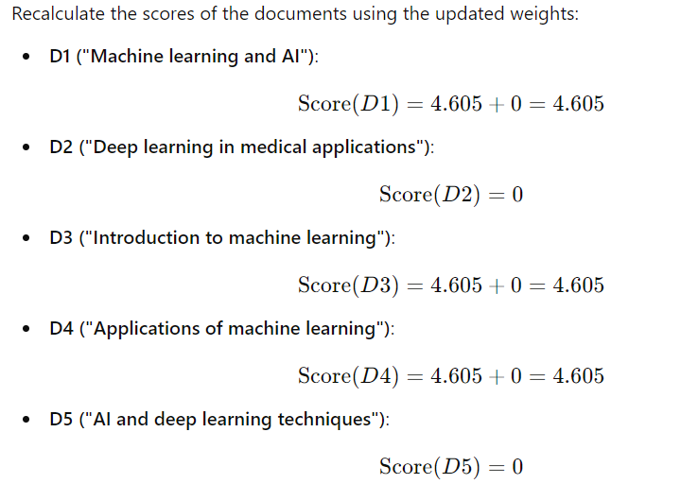
Step 4: New document scores with Reweighted query

Slide 34
Step 5: Final Ranking
After reweighting, the final ranking would prioritize documents containing "machine" since "learning" alone has been identified as less discriminative based on relevance feedback.
D1, D3, D4: Score = 4.605 (most relevant)
D2, D5: Score = 0 (least relevant)

Slide 35
Evaluation of Relevance feedback strategies
Evaluating the retrieval performance of a modified query vector by considering only the residual collection is a more realistic approach because it focuses on the part of the document collection that has not been retrieved by the original query.
This subset of documents is the target of the modified query after relevance feedback is applied.
Why Use the Residual Collection?
Focus on Improvement:The goal of relevance feedback is to refine the query so that previously missed relevant documents are retrieved. By focusing on the residual collection, the evaluation can directly measure the improvement made by the modified query.
Avoiding Overestimation: If you evaluate the modified query against the entire collection, including documents already retrieved by the original query, the performance metrics might be skewed. The modified query might always appear more effective simply because it retrieves documents that were already known to be relevant, rather than finding new relevant documents.
Realistic User Experience:In practical IR systems, users are interested in retrieving additional relevant documents that were missed by the initial query. The residual collection represents the remaining unexplored portion of the collection, making the evaluation more aligned with a real-world search scenario.

Slide 36
How to Implement this Evaluation?
Initial Retrieval:
Perform an initial retrieval using the original query. This will yield a set of documents that are deemed relevant (or irrelevant) based on the original query vector.
Residual Collection Construction:
Construct the residual collection by removing the initially retrieved documents from the entire document collection.
Apply Modified Query:
Apply the modified query vector (after relevance feedback) to the residual collection. This will test the effectiveness of the modifications in finding additional relevant documents that were not retrieved initially.
Performance Metrics:
Calculate precision, recall, and other relevant metrics based on the documents retrieved from the residual collection. This will provide a clearer picture of how well the modified query performs in identifying new relevant documents.
Comparative Analysis:
Compare the performance of the modified query on the residual collection to its performance on the full collection. This helps in understanding whether the modifications are genuinely beneficial in improving retrieval performance beyond what was achieved by the original query.

Slide 37
Benefits of this evaluation approach
Efficiency: Evaluating on the residual collection reduces the number of documents to be processed, making the evaluation more efficient.
Accuracy: It avoids the potential inflation of performance metrics, offering a more accurate assessment of the relevance feedback strategy's effectiveness.
Practical Relevance: It better mimics a real-world scenario where the goal is to uncover new relevant information, rather than simply re-confirming what was already known.
By focusing on the residual collection, the evaluation of the modified query vector becomes more meaningful, realistic, and aligned with the goals of relevance feedback in Information Retrieval systems.

Slide 38
Multimedia IR Models
Link

